Slide 1


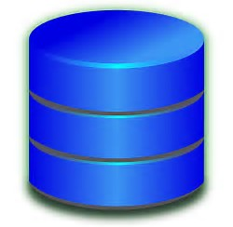
View
Retrieve Information
Controllers from ruby on Rails
Post/ Create/Update Information
Users
Database

